Slide 1
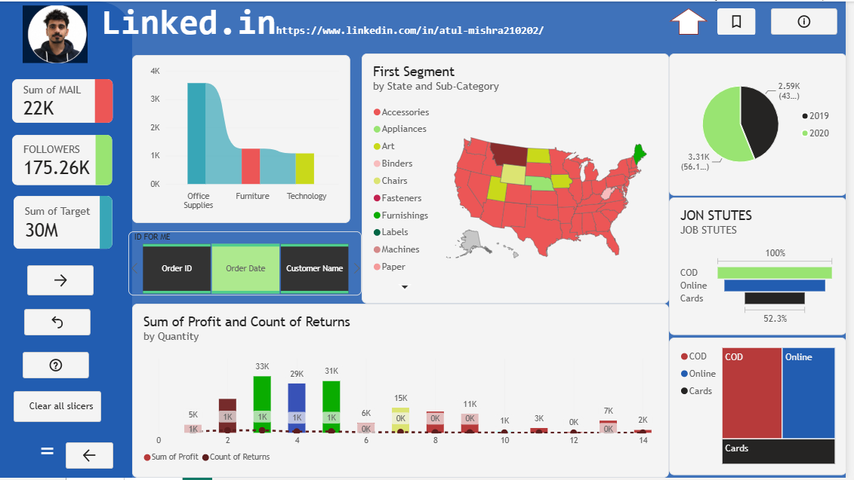
SALES PERFORMANCE
Sales Performance Dashboard
Interactive Power BI report
Presented by Atul Mishra

Slide 2
Project Overview
22K
175.26K
30M
Sum of Mail
Followers
Sum of Target
Built in Power BI with interactive slicers, navigation buttons and a "Clear all slicers" reset
Covers sales by category and state, yearly comparison, profit vs. returns and payment modes
Designed so one page answers the main business questions

Slide 3
Dashboard at a Glance

Slide 4
Sales by Category
Office Supplies leads
It sells roughly three times as much as Furniture or Technology, which are close to each other. Growth levers: lift Furniture and Technology volumes.
Values read from the dashboard (approx.)

Slide 5
2019 vs. 2020
2.59K
2019
3.31K
2020
2020 contributes 56.1% of the total and is about 28% higher than 2019.

Slide 6
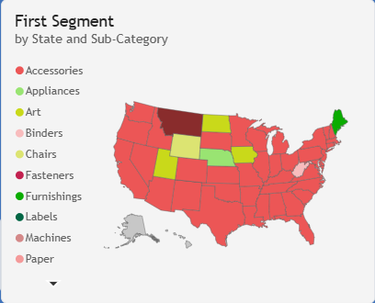
Sales by State and Sub-Category
Map shows the leading sub-category in every US state
Colour-coded legend (Accessories, Appliances, Art, Binders, Chairs and more)
Highlighted states such as Montana, Utah and Nebraska stand out from the rest
Slicers let the viewer drill down by order, date or customer

Slide 7
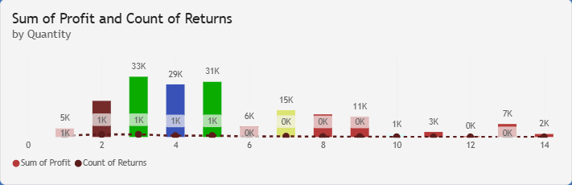
Profit and Returns by Quantity
Profit peaks
33K, 29K and 31K at quantities 3 to 5
Returns
stay low across all quantities
Large orders
add little profit

Slide 8
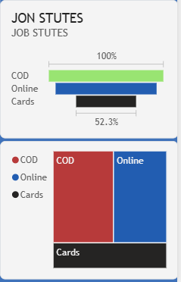
Payment Mode Mix
Three modes tracked: COD, Online and Cards
COD is the largest share; Online is a close second
Cards are the smallest, at 52.3% of the COD level in the funnel
Opportunity: nudge COD customers to online payment

Slide 9
Key Insights and Next Steps
Insights
Next Steps
Office Supplies drives most sales
2020 outperformed 2019
Mid-size orders give the best profit
COD still dominates payments
Grow Furniture and Technology
Investigate returns at quantity 2
Promote online and card payments
Publish the report to GitHub and LinkedIn

Slide 10
Thank You
Atul Mishra
linkedin.com/in/atul-mishra210202

